Slide 1
SIMON
BEHNAZ | SCOTT | MINHO

Slide 2


Slide 3


Slide 4
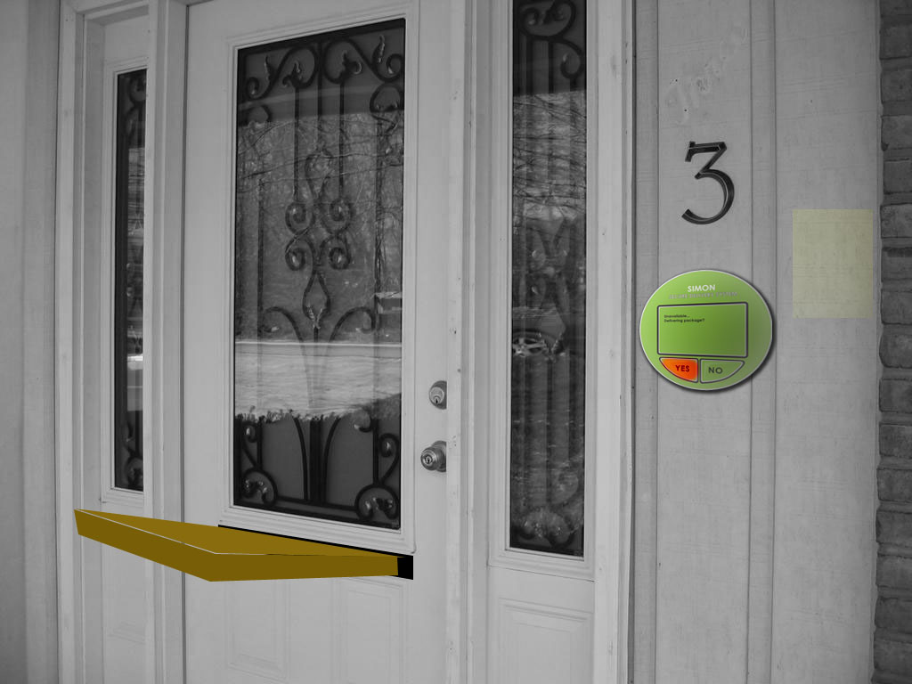

Slide 5
Tracking ID : 34H798DS8K
Statues: Received
Thank you!

